Slide 1
Extensions for Spatial Data
MySQL空间数据扩展

Slide 2
OpenGIS Standard
Open Geospatial Consortium (OGC)
OpenGIS® Implementation Standard for Geographic information - Simple feature access - Part 2: SQL option
http://www.opengeospatial.org/standards/sfs
MySQL implements spatial extensions as a subset of the SQL with Geometry Types environment.
Data types for representing spatial values
Functions for manipulating spatial values
Spatial indexing for improved access times to spatial columns

Slide 3
Concept
geographic feature
geospatial feature
geometry feature
The following material covers these topics:
The spatial data types implemented in MySQL model
The basis of the spatial extensions in the OpenGIS geometry model
Data formats for representing spatial data
How to use spatial data in MySQL
Use of indexing for spatial data
MySQL differences from the OpenGIS specification

Slide 4
Spatial Data Types
single geometry values:
GEOMETRY
POINT
LINESTRING
POLYGON
The other data types hold collections of values:
MULTIPOINT
MULTILINESTRING
MULTIPOLYGON
GEOMETRYCOLLECTION

Slide 5
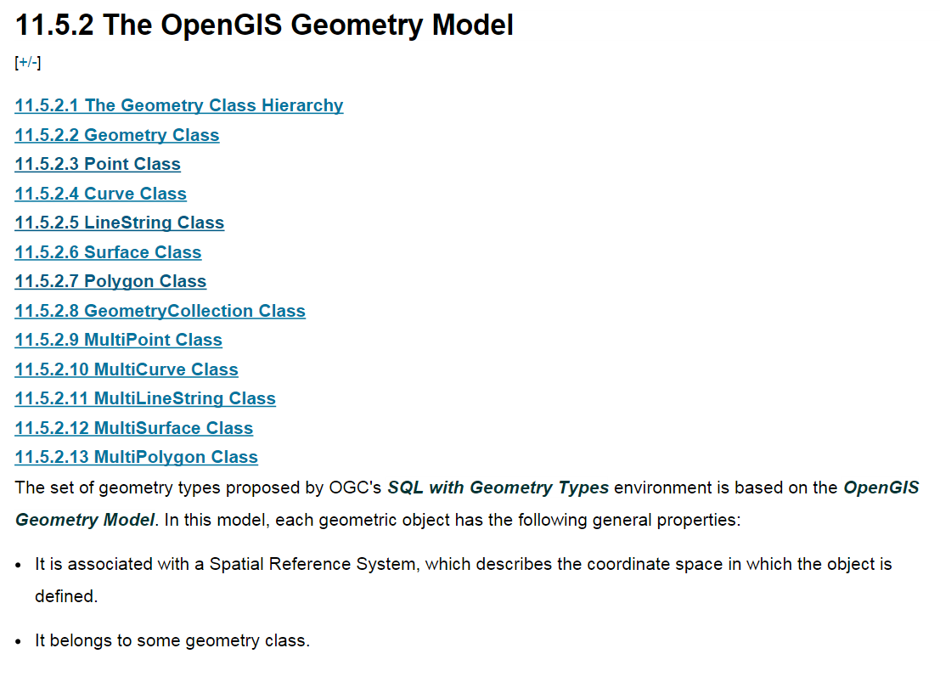
The OpenGIS Geometry Model

Slide 6
Spatial Data Formats
Two standard spatial data formats are used to represent geometry objects in queries:
Well-Known Text (WKT) format
Well-Known Binary (WKB) format
POINT(15 20)
POINT(1 1)
0101000000000000000000F03F000000000000F03F
Byte order: 01
WKB type: 01000000
X coordinate: 000000000000F03F
Y coordinate: 000000000000F03F

Slide 7
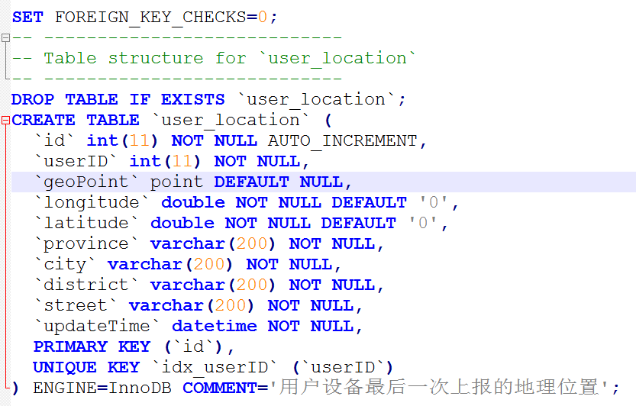
Creating Spatial Columns

Slide 8
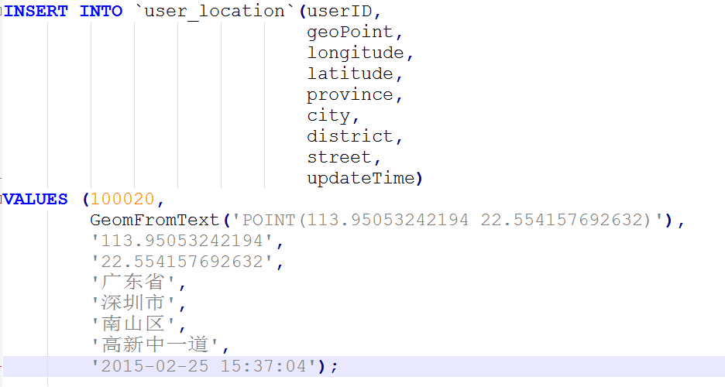
Populating Spatial Columns
INSERT INTO geom VALUES
(GeomFromWKB(0x0101000000000000000000F03F000000000000F03F));

Slide 9
Fetching Spatial Data
mysql> select * from user_location\G;
id: 1
userID: 100020
geoPoint: G|\@g
longitude: 113.95053242194
latitude: 22.554157692632
province: 广东省
city: 深圳市
district: 南山区
street: 高新中一道
updateTime: 2015-02-25 15:37:04
1 row in set (0.00 sec)

Slide 10
Fetching Spatial Data
mysql> SELECT userID, AsText(geoPoint) FROM user_location;
+--------+----------------------------------------+
| userID | AsText(geoPoint) |
+--------+----------------------------------------+
| 100020 | POINT(113.95053242194 22.554157692632) |
+--------+----------------------------------------+
1 row in set (0.00 sec)

Slide 11
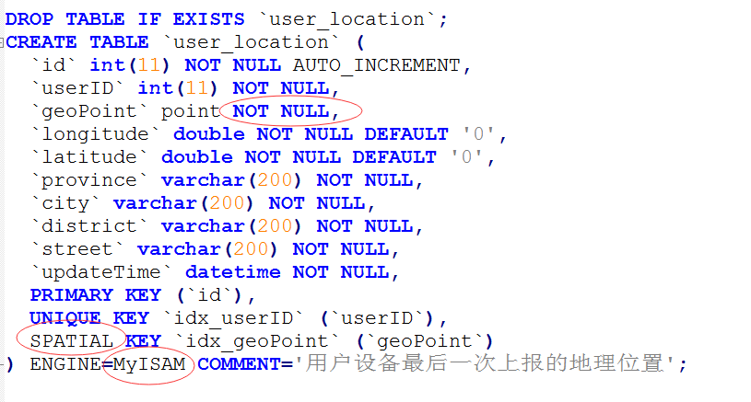
Creating Spatial Indexes
For MyISAM tables, MySQL can create spatial indexes using syntax similar to that for creating regular indexes, but using the SPATIAL keyword. Columns in spatial indexes must be declared NOT NULL
ALTER TABLE user_location ADD SPATIAL INDEX idx_geoPoint(geoPoint);
ALTER TABLE user_location DROP INDEX idx_geoPoint;

